Slide 1

Virtual Music
Practice
Two Primary use cases: 1. Practicing
2. Learning
Learn
Notes:
Home screen that allows the user to select what they would like to do, either practice or learn. It also provides a link to settings, which all pages will have. A selection is required to move on from this page, and every other page

Slide 2
Virtual Music
Clicking takes user to home page
Clicking takes user to settings page
Back
Clicking takes user to previous page
Choose an Instrument
Piano
Instrument options for user. For demonstration, all menu pages assume piano is selected.
Guitar
Theremin
Notes:
Instrument selection screen, gives the user the choice to select what instrument they would like practice, currently being limited to piano, guitar, and theremin. The application name in the top left redirects to the home page. The back button will take the user back to the previous page forgoing the need to traverse from the home page each time they need to change a selection.

Slide 3
Virtual Music
Back
Choose a Learning Plan
Scales
There are three different guided practice options, or learning plans
Beginner Songs
Advanced Songs
Notes:
The learn screen is simple, is currently planned to allow three types to learn an instrument, by way of scales, simple songs, and more difficult songs.

Slide 4
Virtual Music
Back
Choose a Scale
C Major
Here are just three options for scales
G Major
D Major
A button to scroll through more options
Notes:
Scale selection page is what follows if the user previously selected scales on the “learn screen”. There will be more options listed, but to show it off, we have the C, G, and D major scales, with an option to scroll for more.

Slide 5
Virtual Music
Back
Choose a Beginner Piano Song
Chopsticks
Here are just three options for beginner songs to learn
Fur Elise
Jingle Bells
Notes:
A set of beginner piano songs that a user can select from, there will be more options, denoted by the arrow.

Slide 6
Virtual Music
Back
Choose an Advanced Piano Song
Piano Sonata No 5
Here are just three options for advanced songs to learn
Fantasie-Impromptu Op 66
Intermezzo Op 118 No 2
Notes:
A set of advanced piano songs that a user can select from, there will be more options, denoted by the arrow.

Slide 7
Virtual Music
Back
Volume controls for the instrument sound
Settings
Volume controls for a virtual instructor
Instrument Volume
46
Instructor Volume
32
Sound output selection
Sound Output
Computer Speakers
Camera selection
Camera
Computer Webcam
Notes:
Settings/configuration screen. A simple screen that allows the user to adjust the volume for the instructor and instrument, as well as configure their sound output and camera input.

Slide 8
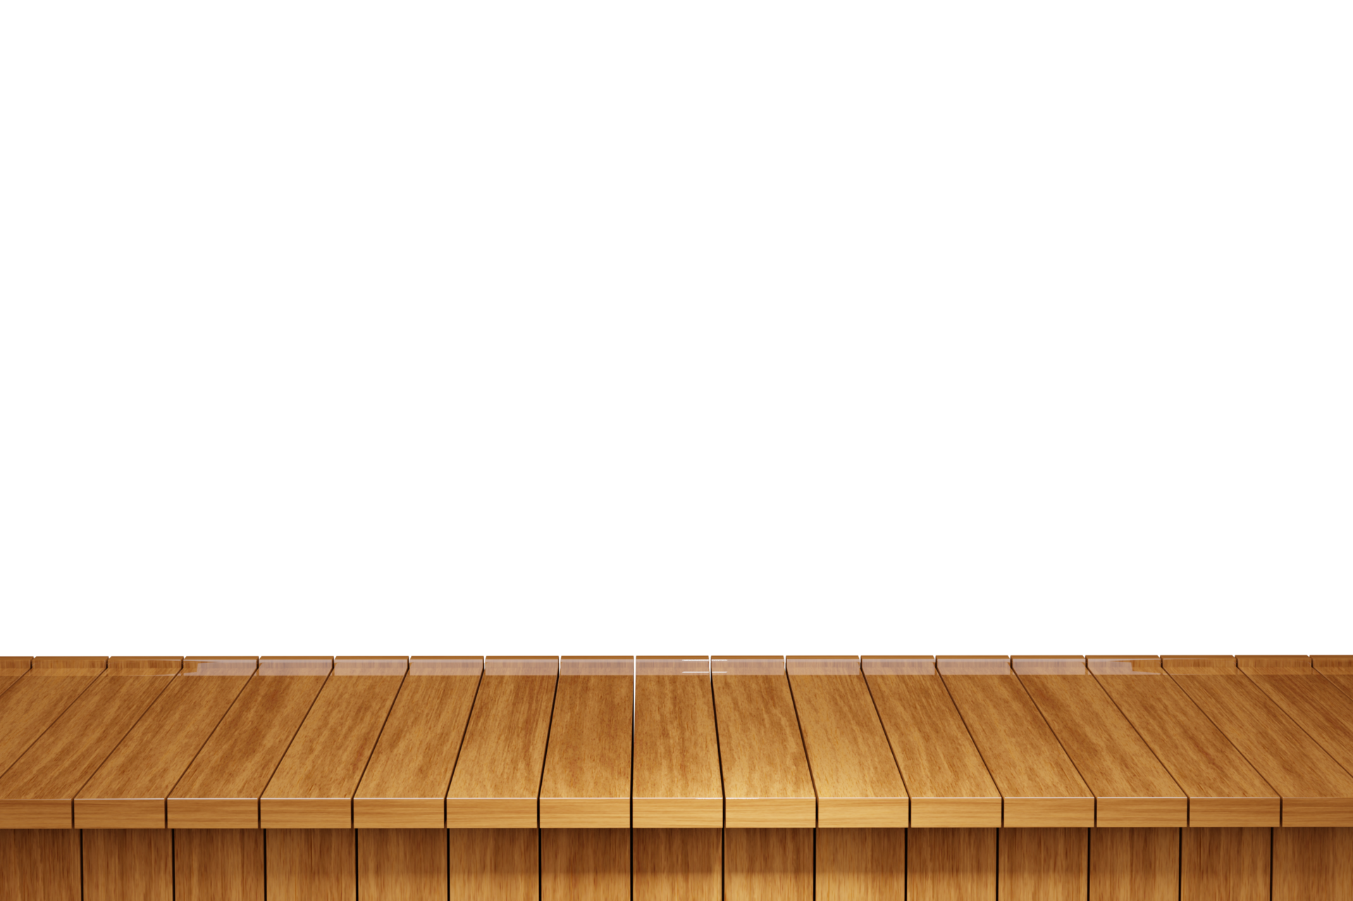
Virtual Music
Back
User (Guitar/Theremin) or surface (piano) is in the frame for software to detect hand movements/positions
Camera Check
Notes:
“Camera Check” shows the relative instrument for the user to test, it will ask them to place their hands within the needed areas to verify the software will be able to detect them.

Slide 9



Virtual Music
Guitar
Back
Frets, activated (blue) by one’s fingers over the area
String area to strum
Notes:
Guitar screen, the UI for the guitar page, showing how the user would interact with the program.

Slide 10

Virtual Music
Piano
Back
Piano keys, activated (blue) by a finger touching them
Notes:
Piano screen, the UI for the piano page, showing how the user would interact with the program.

Slide 11
Virtual Music
Theremin
Back
The theremin is unique because it’s activated by position in the field, rather than “button” pressed
Notes:
Theremin screen, the UI for the theremin page, showing how the user would interact with the program.

